Slide 1
Processing speed and multitasking performance in Counter-Strike players: a cross-sectional study
Eleanor R. A. Hyde
PhD Student
14/02/2024

Slide 2

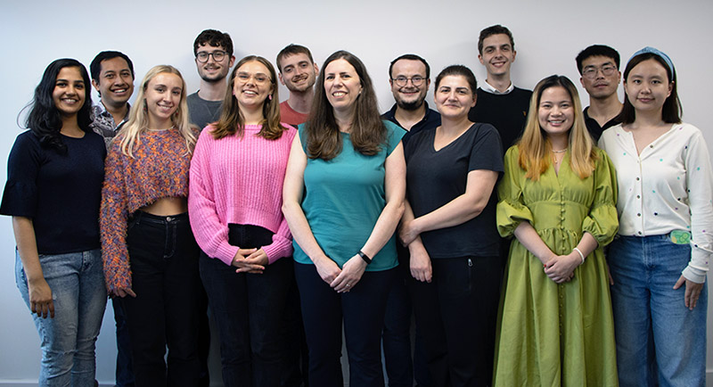



Cognitive Ability & Plasticity Lab
Dr Claudia von Bastian, Senior Lecturer
Notes:
Member of CAP Lab, headed by Dr Claudia von Bastian
Our lab investigates individual differences in cognitive abilities, particularly how our cognitive abilities can change through experience.
By understanding these differences, we can develop interventions which potentially boost cognitive performance
My line of investigation regards how our everyday experiences, such as engagement in leisure activities like video games, shapes cognition.

Slide 3
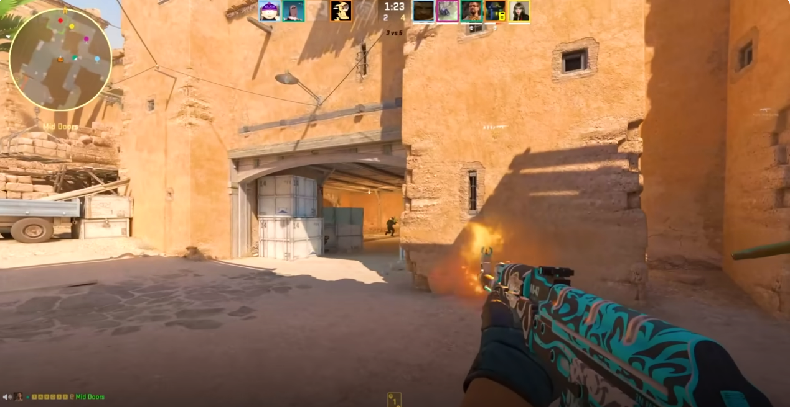
Cognitively stimulating leisure activities
Engagement in leisure activities contributes to a healthy lifestyle, but those with greater cognitive challenge show more potential for inducing cognitive improvements (von Bastian, Hyde & Jiang, 2023)
Notes:
Engagement in leisure activities is thought to contribute to a healthy lifestyle; however, not all activities are made equal, and those which involve a greater cognitive challenge show greater potential for improving cognition.
Video games are a highly popular and challenging leisure activity:
Screenshot from the video game we research, Counter-Strike which is a FPS game: typically featuring dynamic and complex environments which require players to make fast decisions or suffer in-game consequences.
Is there the potential for video games to benefit cognition?

Slide 4


Video games and cognition
Sala et al.
(2018)
Bediou et al. (2018; 2023)
Smith & Basak (2023)
Across video game genres
Action video games
Specific gameplay features
Notes:
Meta-analyses have shown a positive relationship between video play and cognition
Sala found weak correlations between video game play and cognition; however, this analysis included all video game genres
The gameplay of Mario Kart is very different to Call of Duty and likely has different cognitive implications, so it is important to be genre-specific in our research.
Bediou focused on one genre, Action Video Games (included FPS, action role-playing and action-adventure games), and found robust effects of AVG play on a range of cognitive domains such as perception and multitasking.
Smith & Basak examined specific gameplay features, found a significant effect of video game training on cognition, and that different gameplay features are differentially related to cognitive performance.
Further research is necessary in this field to understand how video game play can boost cognition, and the field would benefit from more genre-specific research investigating the cognitive correlates of specific video games.

Slide 5
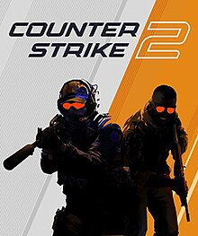
First-Person Shooter games
Notes:
In my research, I examine the cognitive correlates of playing First-Person Shooter games, which are a sub-genre of Action Video games
I’m even more specific focusing on one video game: Counter-Strike
Free-to-play FPS game which is played by many people globally – sample of diverse players
Around for a long time – sample with a broad age range compared to other FPS games
Played at the professional eSports level – which makes it an interesting game to investigate – sample includes players with extremely high expertise levels – allows us to investigate how cognitive performance differs in players with different levels of expertise

Slide 6
Research Questions
How should we measure Counter-Strike expertise?
Is there a relationship between Counter-Strike expertise, processing speed and multitasking performance?
Processing Speed: general ability to process information, measured by Reaction Times (RTs) and Accuracy Scores
Multitasking: Ability to conduct two or more tasks at the same time, measured by Mixing Costs and Switching Costs
Notes:
The first research question was how should expertise in Counter-Strike be measured.
Wanted to investigate this because typically only two measures of video game expertise are used in the literature: self-rated expertise or an estimate of weekly hours of playtime
We wanted to better understand what CS expertise is and how we can measure it.
Secondly, following the promising meta-analyatic findings regarding perceptual and multitasking performance in video game players,
Wanted to investigate the relationship between CS expertise, processing speed and multitasking performance
So we’re on the same page:
Processing speed is our general ability to process information and is typically measured with RTs and accuracy scores
Multitasking is our ability to do two or more tasks at the same time, typically measured by mixing and switching costs

Slide 7
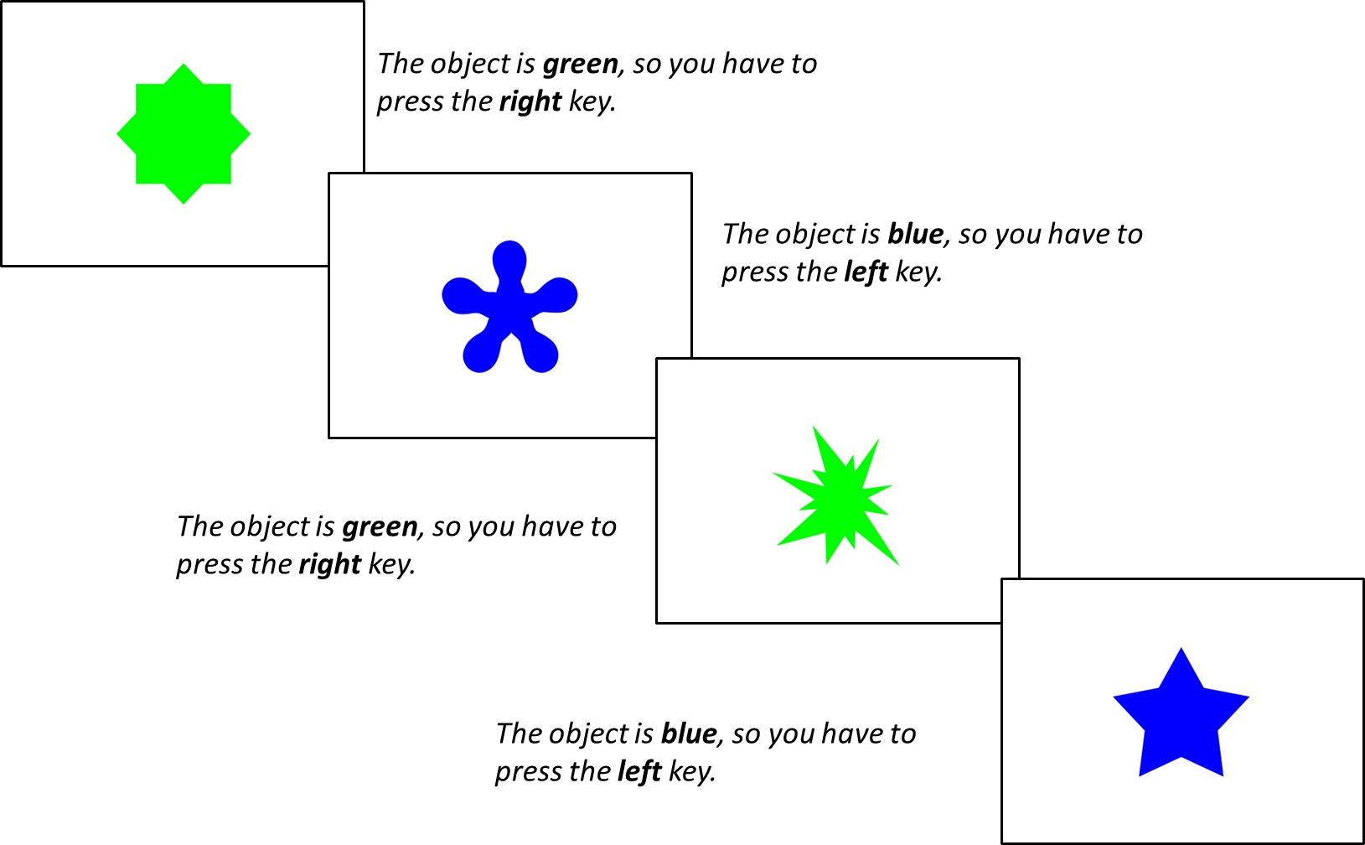
Method
Choice Reaction Time Task
Three Blocks:
Single-rule 1: 64 trials of shape followed by 64 trials of colour
Mixed-rule: 129 trials switching between shape and colour rule
Single-rule 2: 64 trials of colour followed by 64 trials of shape
n = 385
Within the Mixed-Rule Block:
Repetition trials: two successive trials in which the same rule is applied (shape + shape)
Switch trials: rule changed from the preceding trial to the current trial (shape + colour)

Slide 8
Method
Choice Reaction Time Task
Three Blocks:
Single-rule 1: 64 trials of shape followed by 64 trials of colour
Mixed-rule: 129 trials switching between shape and colour rule
Single-rule 2: 64 trials of colour followed by 64 trials of shape
n = 385
Mixing Costs: RT performance cost of mixing two tasks
Switching Costs: RT performance cost of switching from one task to another
Notes:
Mixing costs repetition-trial RTs - single-trial RTs)
Switching costs switch-trial RTs – repetition-trial RTs – more informative

Slide 9

Method
Choice Reaction Time Task
Pro
Expert
Casual
CS Questionnaire
Total hours of playtime
Weekly hours of playtime
Current Ranking in CS
Self-rated expertise
Notes:
Questionnaire informed by CS players who we interviewed ahead of this study

Slide 10
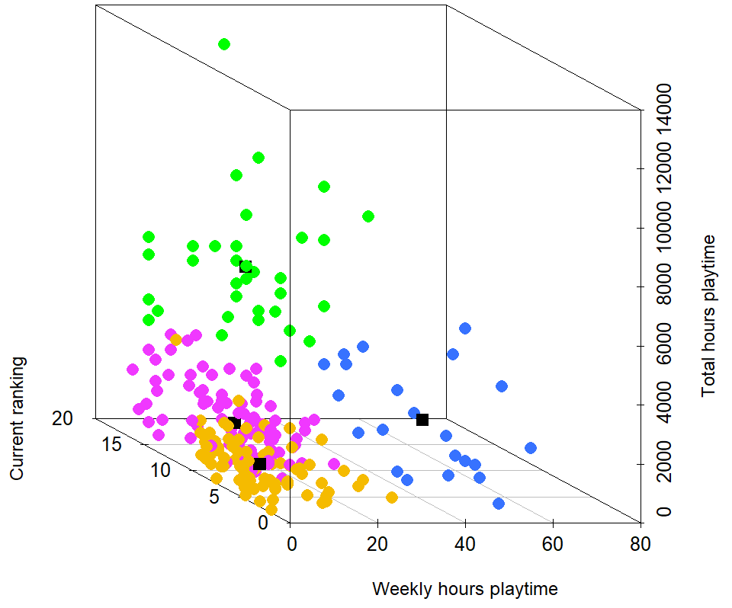
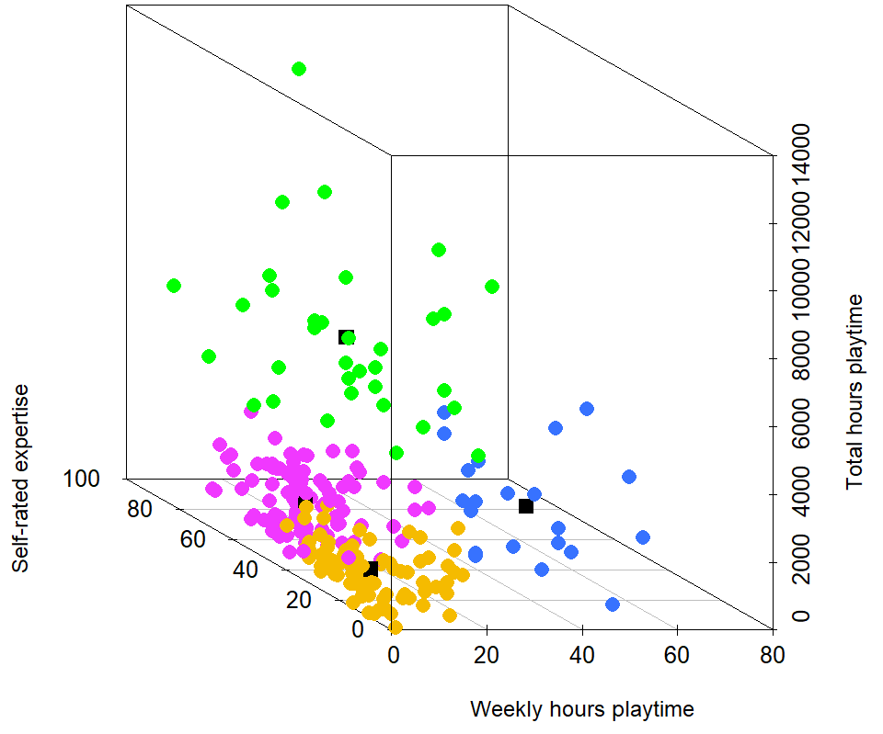
K-means cluster analysis
N = 235
Semi/Professional
Aspiring
Experienced
Casual
scatterplot3d function from the scatterplot3d package in R
Notes:
3d scatter plot with our four expertise variables on the following axis:
weekly hours on the x
total hours on the y
current ranking on the z in the left plot and self-rated expertise on the z in the right plot
Inputted the four expertise variables into a K-means cluster analysis an machine learning algorithm which groups observations into k-cluster groups: goal being to group similar observations together to discover any underlying patterns.
Analysis suggested that 4 Cluster Groups would best fit our data: Semi/Pro, Aspiring, Experienced and Casual players – each differing in terms of their expertise
Displays the range of expertise in our participants - amazing overview of the expertise of our sample in greater depth than would have been possible with one measure of video game expertise
Lets see how our expertise groups did on the Choice RT task

Slide 11
Processing Speed
No evidence in favour of a main effect of expertise group on mean accuracy scores. p = .326, BF = 0.10
Decisive evidence in favour of a main effect of expertise group on single trial RTs. p <.001, BF = 508.10
Decisive evidence in favour of a main effect of expertise group on switch trial RTs. p <.002, BF = 16.92
But, no evidence in favour of a main effect of expertise group on repetition trial RTs. p = .055, BF = 0.74
M = 591, SD = 112
Notes:
We found no differences in terms of accuracy scores – expertise groups were equally as accurate as each other on the task.
However, our more expert players showed faster RTs on single and switch rule trials.
Let’s have a look at the single-trial RT data.

Slide 12
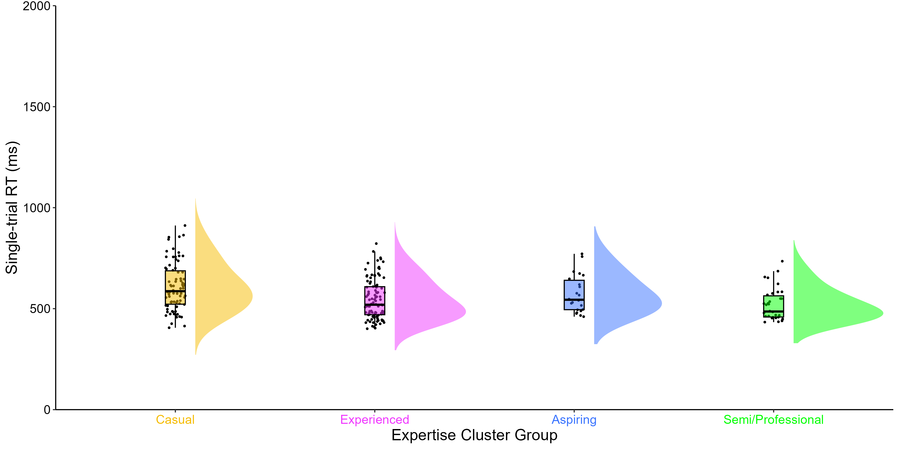
Single trial RTs
Decisive evidence in favour of a main effect of expertise group on single trial RTs. p <.001, BF = 508.10
M = 607.64 ms
SD = 118.60 ms
M = 519.12 ms
SD = 79.20 ms
raincloudplots and PupillometryR packages in R
M = 591, SD = 112
Notes:
Raincloud plot:
Y axis = RTs
X axis = Expertise groups
Dots = participant
Box plot = summarises data from each group (maximum, minimum, interquartile range and median)
Cloud = distribution
Nearly 90ms difference in mean single RTs between Casual players compared to Semi/Professional players – demonstrating that more expert CS players have faster RTs compared to less expert players, without any sacrifices in accuracy: no evidence that players made a speed-accuracy trade off.
But what did their multitasking performance look like?

Slide 13
Multitasking
No evidence in favour of a main effect of expertise group on mixing costs. p = .921, BF = 0.03
Substantial evidence in favour of a main effect of expertise group on switching costs. p <.006, BF = 6.56
M = 591, SD = 112
Notes:
Mixing costs were similar across groups
But there was a difference in Switching Costs between groups, but it might surprise you.

Slide 14
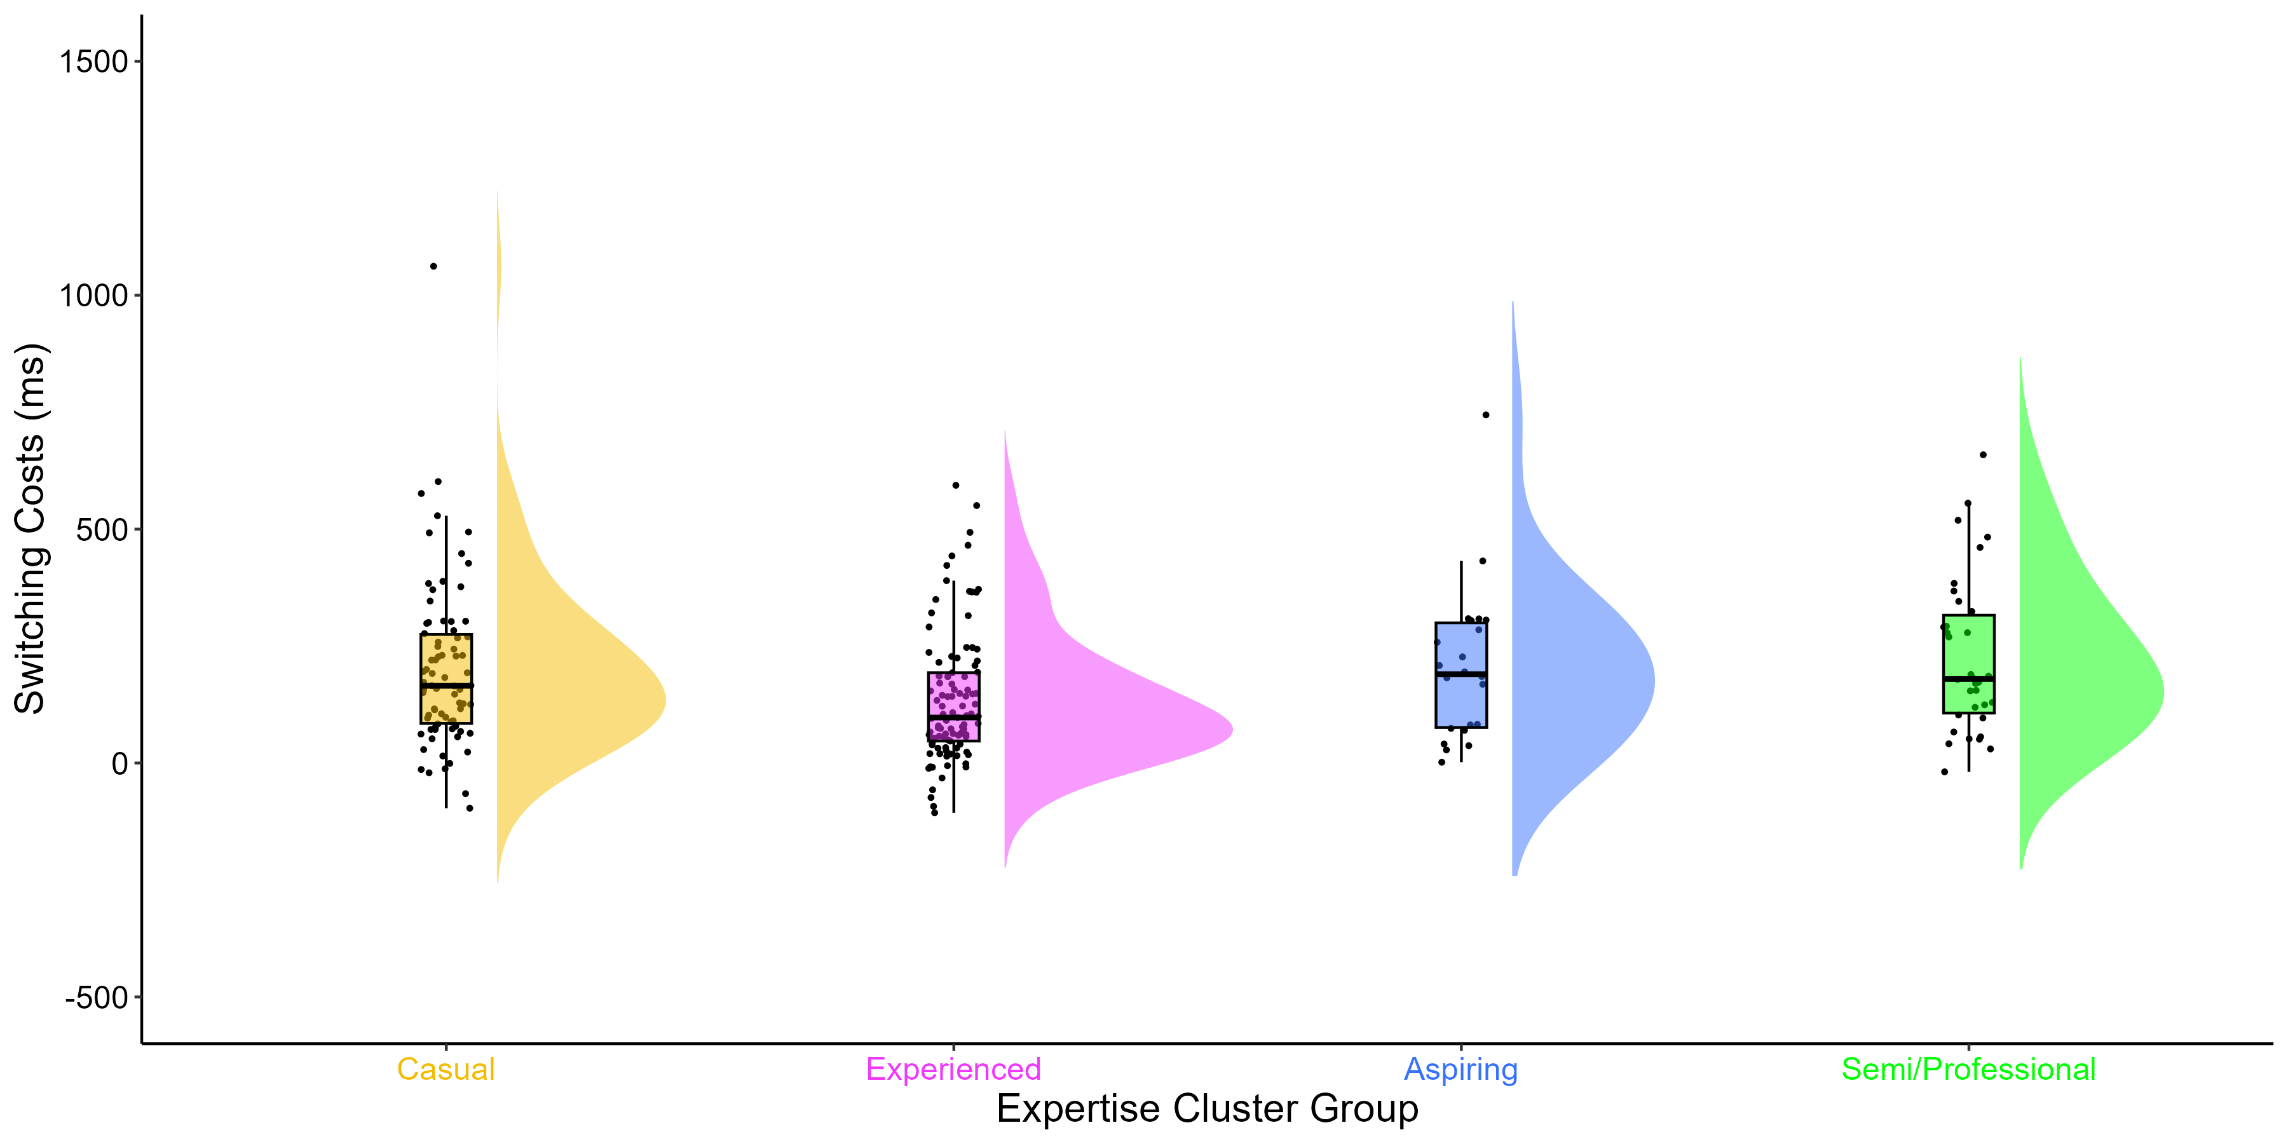
Switching Costs
Substantial evidence in favour of a main effect of expertise group on switching costs. p <.006, BF = 6.56
M = 200.19 ms
SD = 177.53 ms
M = 135.64 ms SD = 139.59 ms
M = 227.72 ms SD = 167.16 ms
raincloudplots and PupillometryR packages in R
M = 591, SD = 112
Notes:
Over 90ms difference in Switching Costs between Experienced players compared to Semi/Professional players
Over 60ms difference in Switching Costs between Experienced players compared to Casual players
Our Experienced players had the lowest Switching Costs, meaning that they were better able to switch between one task and another, than our Casual and Semi/Professional players.

Slide 15
Conclusion
CS expertise was measured with four variables and k-means cluster analysis
Semi/Professional players had faster RTs, whilst Experienced players had greater switching performance.
Further analysis:
Computational modelling (the drift-diffusion model) was used to understand the decisional processes that underlie the processing speed performance differences in CS players.
May be other measures?
Can similar measures be used in other genres?
Do more expert players need to multitask less, and thus rely on RTs more?
Notes:
We measured CS expertise with four variables and a k-means cluster analysis which well-described the expertise of our large sample
But there may be other measures we haven’t investigated yet, and we don’t know if all of these measures can be used or applied to other video game genres yet.
We found a relationship between CS expertise and processing speed, in that more expert players had faster RTs
However, our Experienced players showed the greatest multitasking performance.
We have a theory regarding our multitasking findings: perhaps when you reach a high level of expertise in the game, you don’t multitask any more but are more focused on specific tasks, whilst new players do everything at once, spreading themselves thin across lots of tasks.
Got further investigation to do there.
Also did some computational modelling on the RT and accuracy score data. Although we won’t have time to go into that today, it has helped us understand processing speed performance advantages more.

Slide 16



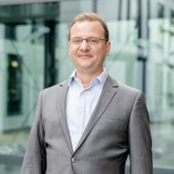


Thanks for listening!
erahyde1@sheffield.ac.uk
www.eleanorhyde.com
Dr Claudia von Bastian
The University of Sheffield
Dr Robert Schmidt
Ruhr-Universität Bochum
Dr Dan Carroll
The University of Sheffield
Endpoint
Notes:
With that, I’d like to thank my amazing supervisory team and Endpoint (our eSports team collaborator), and thank you all for listening.

Slide 17
Participants (N = 235)
 | Full Sample |  | Casual |  | Experienced |  | Aspiring |  | Semi/Professional
 | M | SD | M | SD | M | SD | M | SD | M | SD
Gender Male/Female/Non-Binary/Prefer not to say | 211/21/1/2 |  | 71/6/1/0/1 |  | 84/15/1/1 |  | 22/0/0/0 |  | 34/0/0/0
Age | 21.93 | 4.69 | 34.00 | 21.27 | 33.00 | 23.77 | 25.00 | 18.05 | 29.00 | 20.38
Total hours playtime | 1565.16 | 1926.80 | 624.17 | 534.54 | 1010.11 | 862.32 | 1469.11 | 970.88 | 5434.88 | 2082.08
Weekly hours playtime | 20.34 | 15.85 | 10.26 | 7.55 | 17.05 | 7.98 | 55.55 | 12.11 | 30.41 | 12.54
Self-rated expertise | 50.68 | 23.48 | 26.12 | 12.30 | 62.96 | 15.33 | 48.95 | 17.59 | 71.65 | 17.50
Current Ranking | 12.04 | 4.68 | 7.74 | 2.86 | 13.39 | 2.98 | 11.41 | 5.11 | 18.29 | 1.77

Slide 18

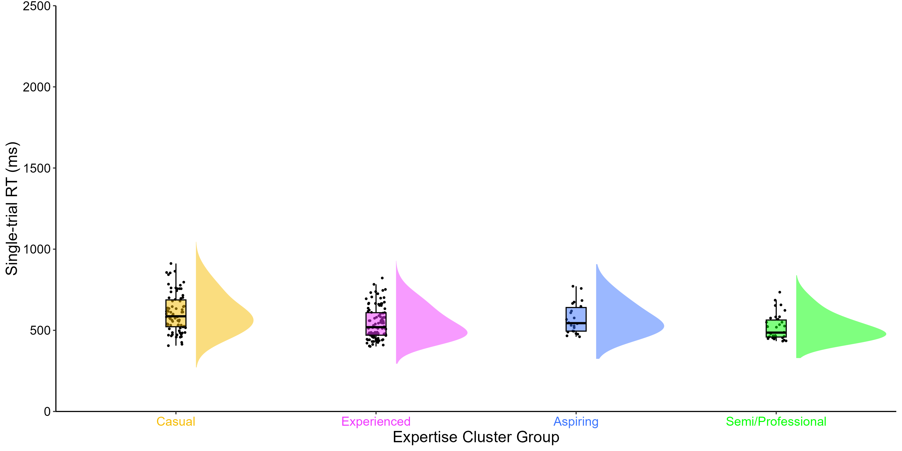
Drift diffusion modelling
No differences in accuracy, but Semi/Professional players have faster RTs
No differences in mixing, but Experienced players have better switching performance.
Drift Rate (v)
Green
Boundary Separation (a)
Blue
Stimuli Encoding
Decision Time
Response Execution
Non-decision time (t0)
Notes:
We found no differences in accuracy between our expertise groups, but we found highly expert CS players had faster RTs than less expert players
Suggesting that CS expertise is associated with faster processing speed performance, with no sacrifices in accuracy
To investigate this further, we used a Drift-Diffusion model which takes RT and accuracy score measures, and disseminates them into three new measures
Drift rate = rate of information accumulation – how fast you are when gathering information during the task
Boundary separation = response caution – how careful you are when making your response during the task
Non-decision time = encoding and response execution – encoding is your first experience in perceiving and learning information from the task, response execution is literally the rate at which you hit the button for green/blue
These 3 measures give us a lot more detailed information about the processing speed of our players

Slide 19
Drift rates (v) across trial types
No evidence in favour of a main effect of expertise group on single trial drift rates (v): p =.091, BF = 0.29
No evidence in favour of a main effect of expertise group on repetition trial drift rates (v): p =.0103, BF = 0.30
But, substantial evidence in favour of a main effect of expertise group on switch drift rates (v): p =.006, BF = 3.67
M = 591, SD = 112
Notes:
Limited evidence
Lets take a look at Drift rates in switch trials across our players

Slide 20
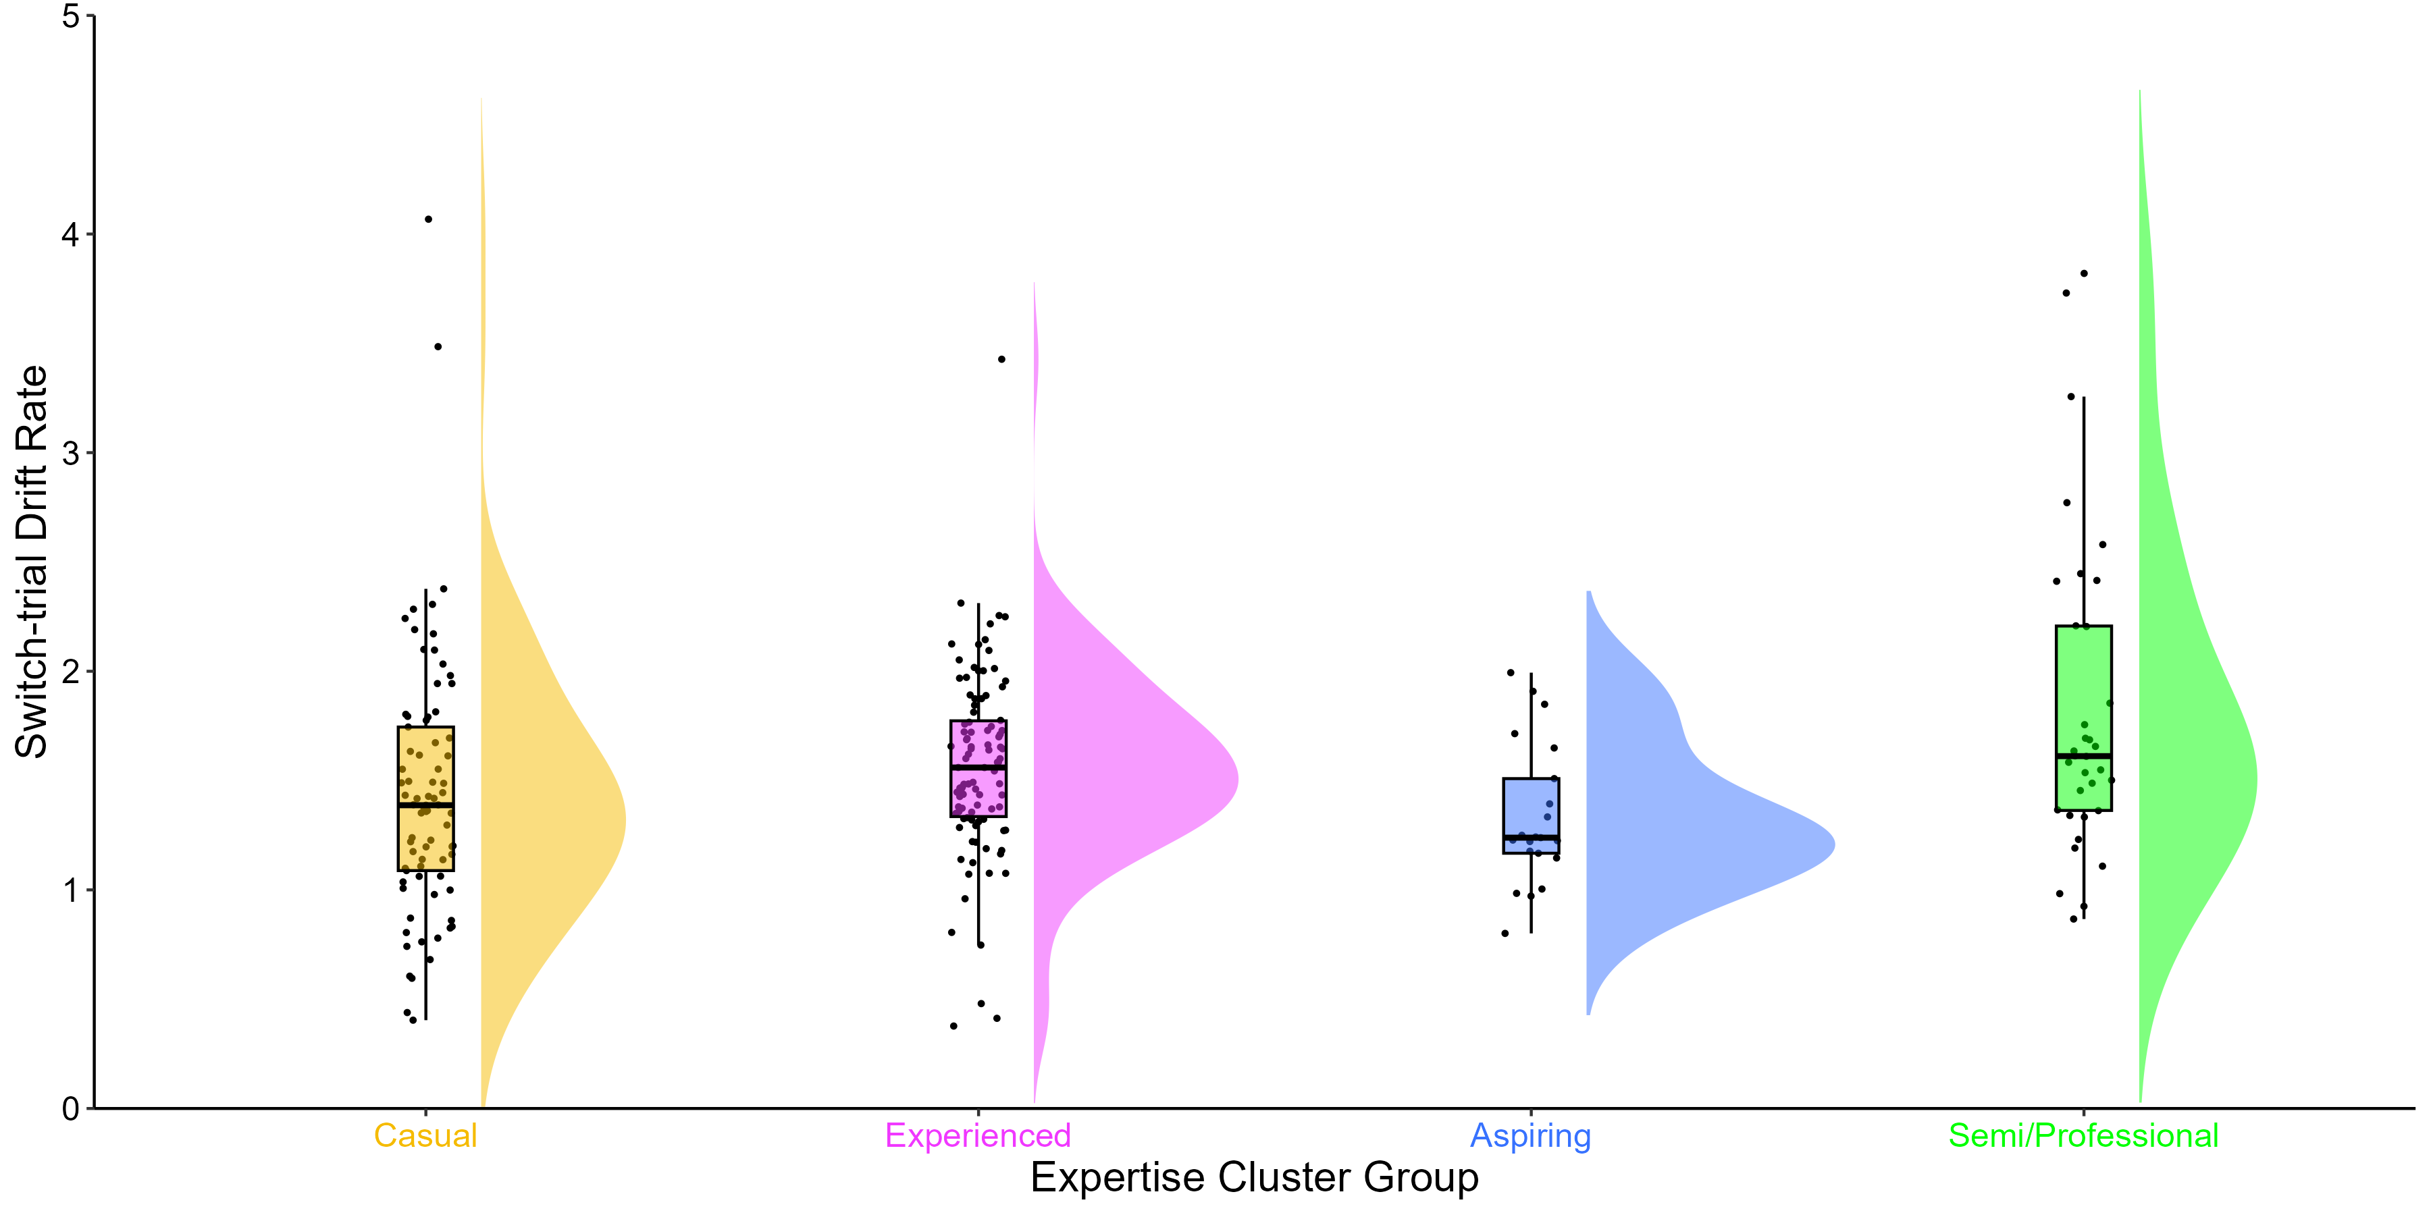
Switch trial Drift Rates (v)
Substantial evidence in favour of a main effect of expertise group on switch drift rates (v): p =.006, BF = 3.67
M = 1.35
SD = 0.33
M = 1.83
SD = 0.74
raincloudplots and PupillometryR packages in R
M = 591, SD = 112
Notes:
Our Semi/Professional players had higher Drift Rates, meaning that they had a faster rate of information accumulation than Aspiring players

Slide 21
Boundary Separations (a) across trial types
Decisive evidence in favour of a main effect of expertise group on single trial boundary separations (a): p =.011, BF = 3.73
No evidence in favour of a main effect of expertise group on repetition trial boundary separations (a): p =.268, BF = 0.13
No evidence in favour of a main effect of expertise group on switch trial boundary separations (a): p =.196, BF = 0.20
M = 591, SD = 112
Notes:
Limited evidence
Lets take a look at Boundary Separations in Single trials across our players

Slide 22
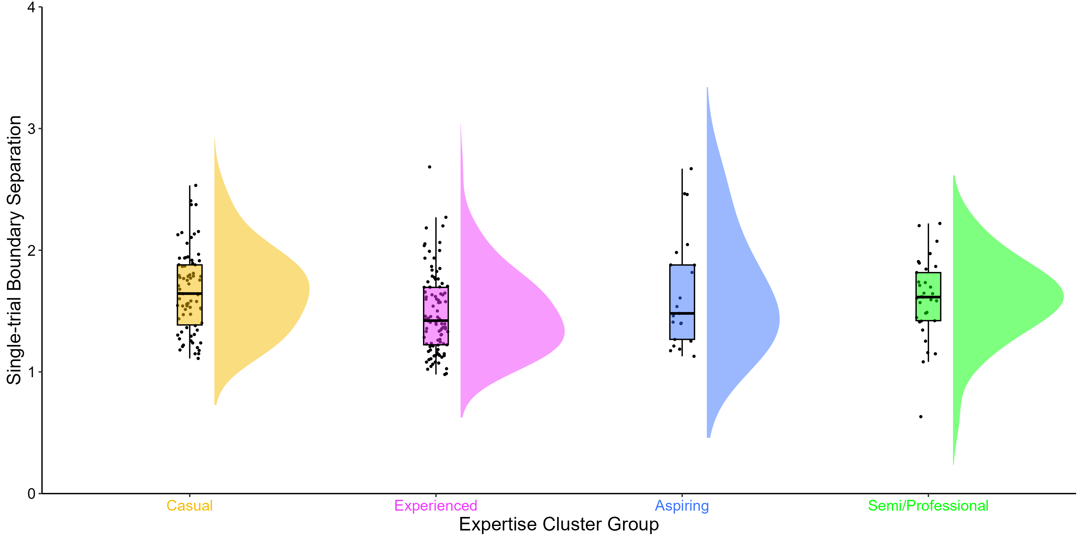
Single trial Boundary Separations (a)
Decisive evidence in favour of a main effect of expertise group on single trial boundary separations (a): p =.011, BF = 3.73
M = 1.75
SD = 0.56
M = 1.48
SD = 0.33
raincloudplots and PupillometryR packages in R
M = 591, SD = 112
Notes:
Our Experienced had lower Boundary Separations, meaning that they were less cautious in their decision making compared to Casual players

Slide 23
Non-decision times (t0) across trial types
Decisive evidence in favour of a main effect of expertise group on single trial non-decision times (t0): p <.001, BF = 279.59
No evidence in favour of a main effect of expertise group on repetition trial non-decision times (t0): p =.204, BF = 0.18
No evidence in favour of a main effect of expertise group on switch trial non-decision times (t0): p =.900, BF = 0.03
M = 591, SD = 112
Notes:
Finally, lets look at Non-decision times
Lets take a look at Non-decision times in Single trials across our players

Slide 24
Single trial Non-decision times (t0)
Decisive evidence in favour of a main effect of expertise group on single trial non-decision times (t0): p <.001, BF = 279.59
M = 0.29
SD = 0.08
M = 0.28
SD = 0.07
M = 0.23
SD = 0.10
raincloudplots and PupillometryR packages in R
M = 591, SD = 112
Notes:
Our Semi/Professional palyers had shorter Non-decision times, meaning that they were faster in terms of encoding of the stimuli and in initiating the motor response, compared to both Casual and Experienced players
Compared to our Drift Rate and Boundary Separation findings – this finding is much more robust, reflected by the high Bayes Factor.

